Slide 1
5G Introduction
5th Generation of Mobile Network

Slide 2

Topics of discussion
What is 5G ?
Why is it needed ?
More about 5G

Slide 3
What is 5g technology ?
Next major phase of mobile industry beyond 4G.
It is designed to meet very large growth in data and connectivity of today’s modern society.
It will fulfill “4A Paradigm”
Anywhere
Anytime
Any rate
Affordable

Slide 4




WHY IS THERE A NEED Of 5G ?
To handle data growth and deliver at lower cost/bit
Power up IOT, bring greater speed to connectivity.
Improve national Security

Slide 5
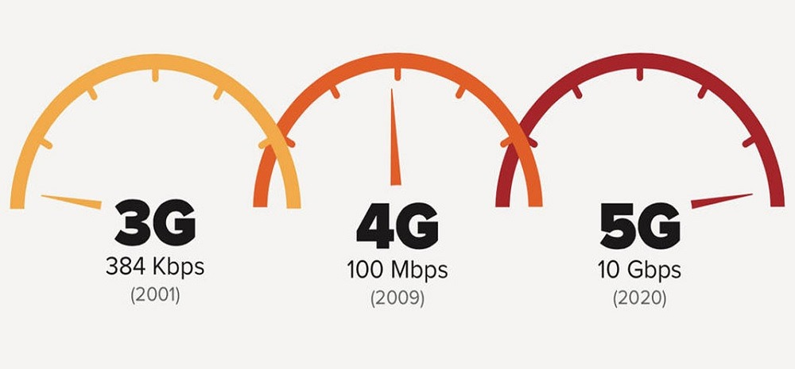
MORE ABOUT 5G !!
Increased Network Capacity
The amount of traffic network can handle.
It is estimated that peak download rate of data will be 20Gbps and upload rate will be 10Gbps.

Slide 6
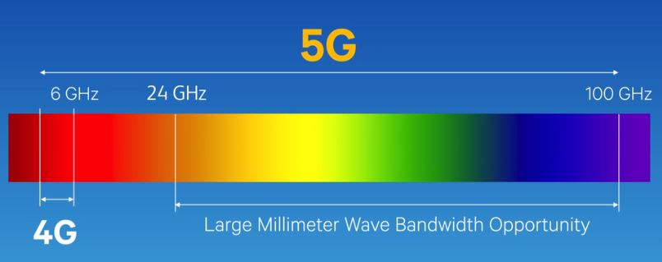
Increased Bandwidth
The range of frequencies a signal occupies is called the bandwidth.
The 5G speeds in the less common millimeter wave spectrum which has much more abundant bandwidth hence greater frequency.

Slide 7
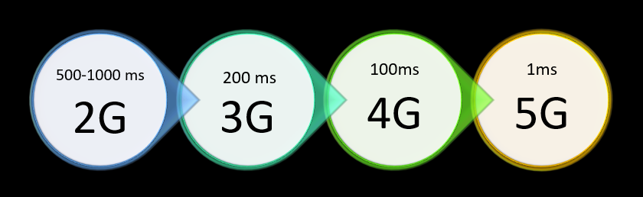
Reduced Latency
5G solves the problem of latency i.e. the delay between the command and response time.
With 4G network we are getting average latency of 50ms that could drop to 1ms with 5G technology.

Slide 8
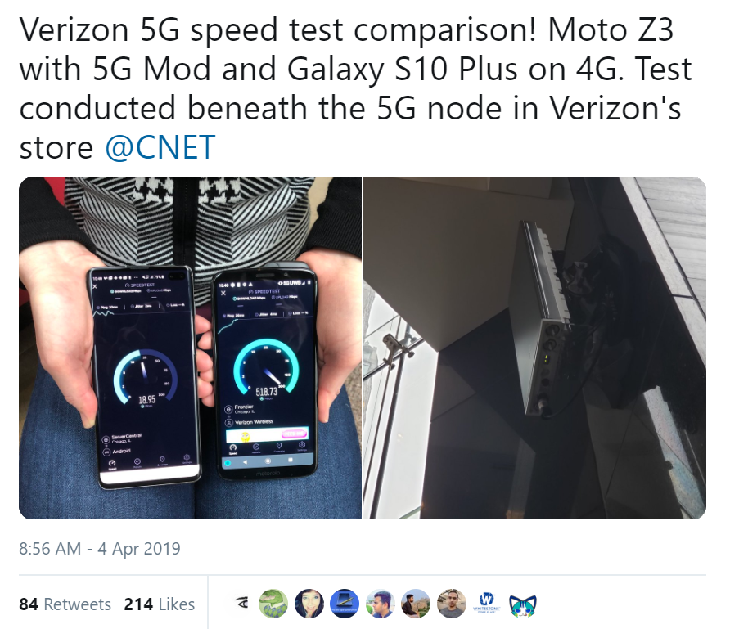

Slide 9



